Slide 1
Deep Generative Models for Tractable Densities

Slide 2
Overview
Supervised Vs Unsupervised Learning
What is a Generative Model
Why Generative Models
Taxonomy of generative models
Detailed discussion about PixelRNN, PixelCNN, and Wavenet

Slide 3
Supervised vs Unsupervised Learning
Supervised Learning
Data: (x,y)
X is data, y is label
Goal: Learn a function to map x-> y
Examples: Classification, regression,
Object detection, Semantics segmentation, image captioning, etc.
Unsupervised Learning
Data: x
Just data, no labels
Goal: Learn underlying hidden structure of the data
Examples: Clustering, dimensionality reduction, feature learning, density estimation, etc.

Slide 4
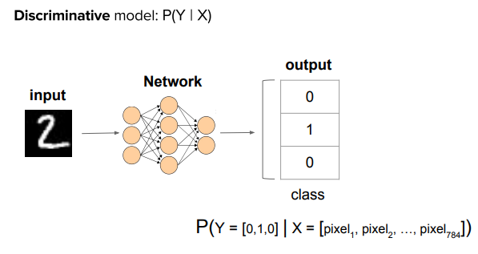
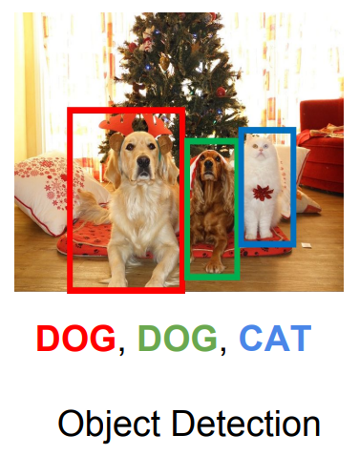
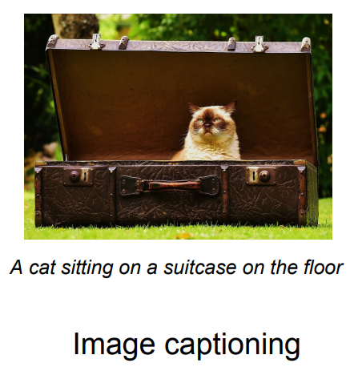
Supervised vs Unsupervised Learning
Supervised Learning
Data: (x,y)
X is data, y is label
Goal: Learn a function to map x-> y
Examples: Classification, regression,
Object detection, Semantics segmentation, image captioning, etc.

Slide 5
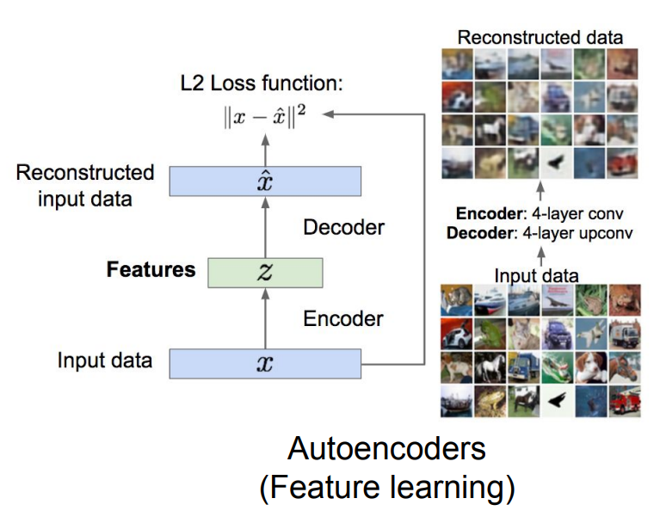
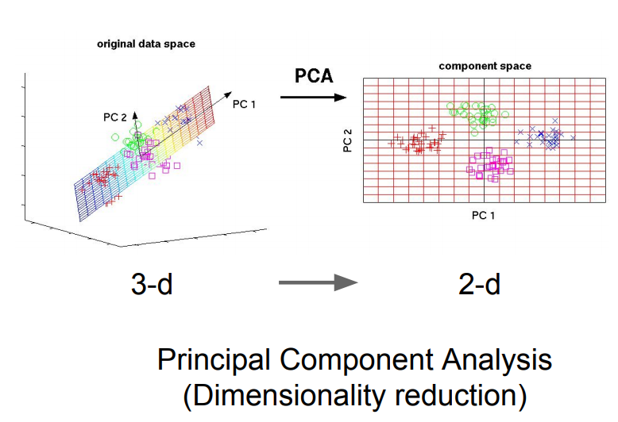
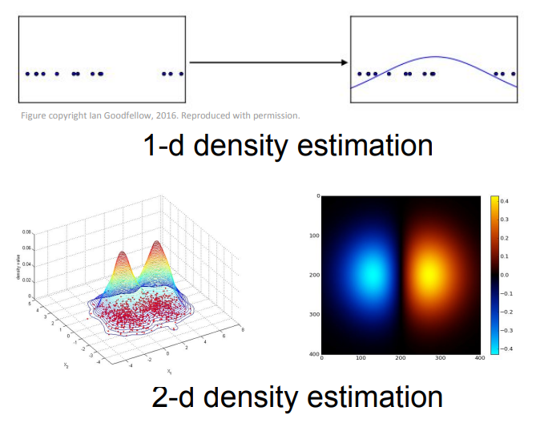
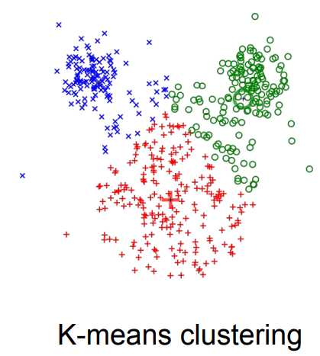
Supervised vs Unsupervised Learning
Unsupervised Learning
Data: x
Just data, no labels
Goal: Learn underlying hidden structure of the data
Examples: Clustering, dimensionality reduction, feature learning, density estimation, etc.

Slide 6
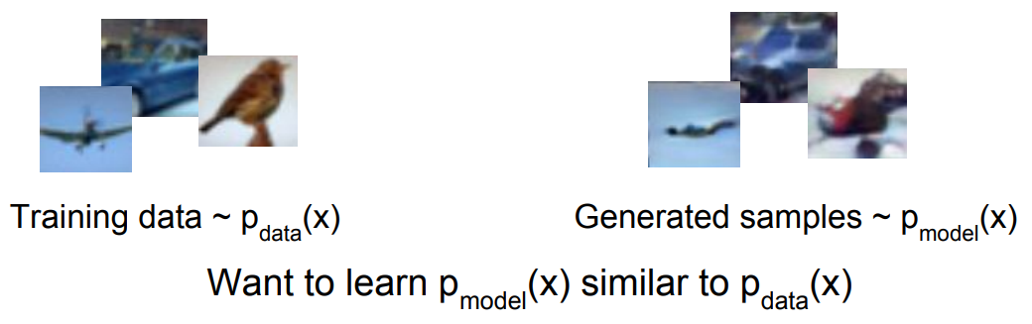
Generative Models
Addresses density estimation, a core problem in unsupervised learning
Several flavors:
Explicit density estimation: explicitly define and solve for Pmodel(X)
- Implicit density estimation: learn model that can sample from Pmodel(X) w/o explicitly defining it
Notes:
We want learn p_model to be similar to p_data

Slide 7
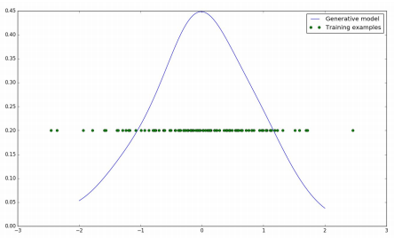
What is a generative model?
We want our model with parameters θ to output samples distributed Pmodel, matching the distribution of our training data Pdata or P(X).
Example: y = f(x), where y is scalar, make Pmodel similar to Pdata by training the parameters θ to maximize their similarity
if we have 1-D data that basically following a gaussian distribution(green dots), then a perfectly trained model (Pmodel) need to learn the μ and σ of the data distribution (Pdata)

Slide 8
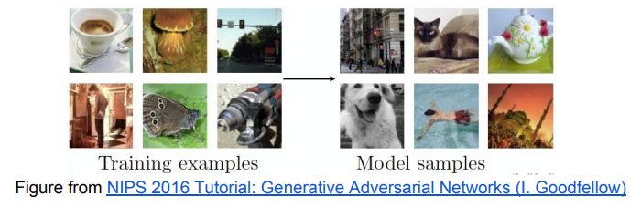
What is a generative model?
Key Idea: our model cares about what distribution generated the input data points, and we want to mimic it with our probabilistic model. Our learned model should be able to make up new samples from the distribution, not just copy and paste existing samples!
Notes:
New data that do not exist, but are realistic. It like, we have seen many rabbits, then we learn to draw rabbits

Slide 9
Why Generative Models?
Model very complex and high-dimensional distributions.
Be able to generate realistic synthetic samples
Possibly perform data augmentation
Simulate possible futures for learning algorithms
Fill the blanks in the data
Manipulate real samples with the assistance of the generative model
Ex: edit pictures with guidance

Slide 10
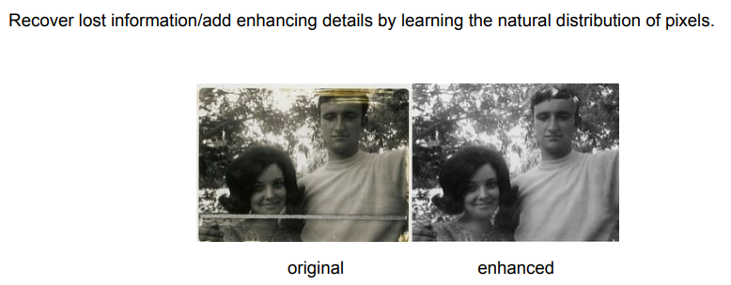
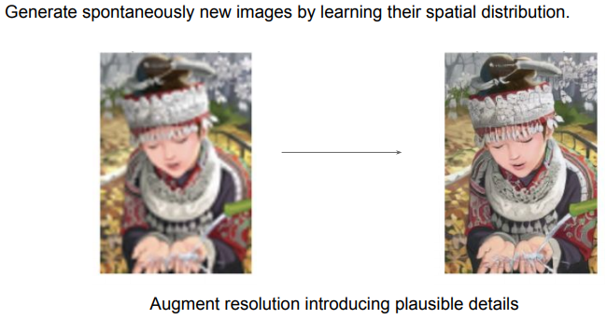
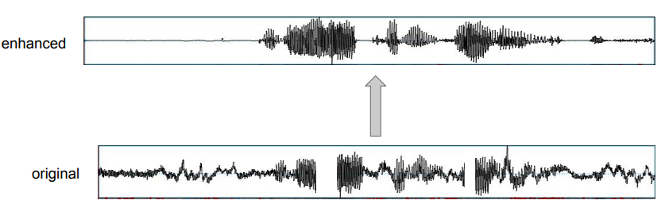

Slide 11
Taxonomy of Generative Models
Generative Models
Explicit density
Implicit density
Tractable Density
Approximate Density
PixelRNN/CNN and Wavenet
NADE
MADE
Variational
Markov Chain
Boltzmann Machine
Variational Autoencoder
Direct
Markov Chain
GAN
GSN
Notes:
NADE - Neural Autoregressive Distribution Estimation
MADE - Masked Autoencoder for Distribution Estimation
GSN - Generative Stochastic Networks
Explicit density estimation: explicitly define and solve for Pmodel(X)
Implicit density estimation: learn model that can sample from Pmodel(X) w/o explicitly defining it
Tractable Density – we have a mathematical decomposition of it, then we know how the distribution is, and we model it like that
Approximate Density – which is not the real density, but something that is close enough to generate the good quality samples
Implicit desity, is we are not directly modeling, its just learning implicitly a distribution. Its learning a distribution but we do not know how its learning, we know the efect of learning that distribution but we are not the cause way it is learning that

Slide 12
Problem formulation for Tractable density modeling

Slide 13
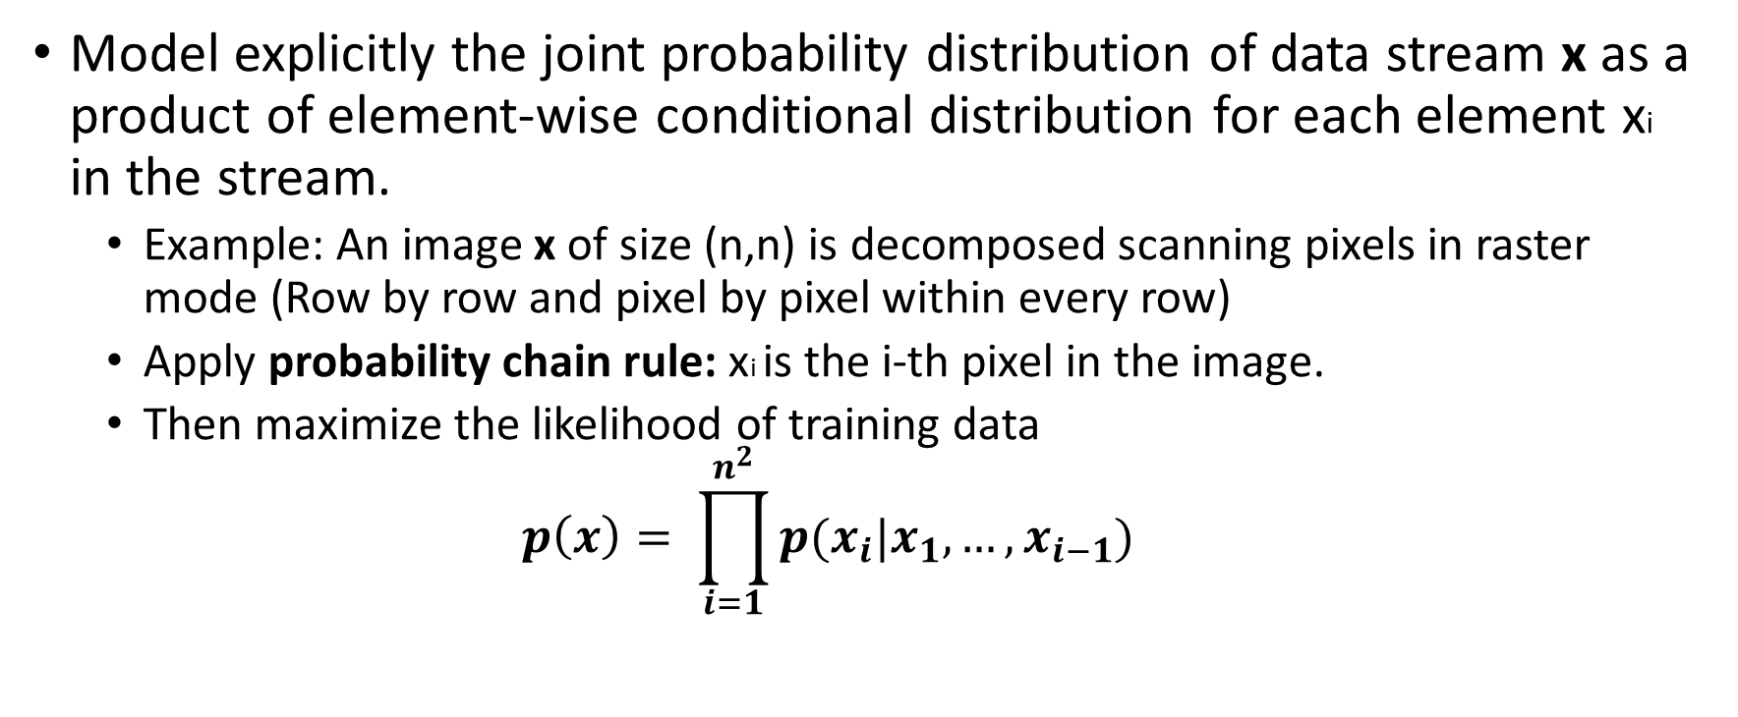
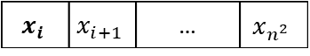
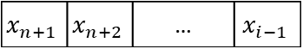
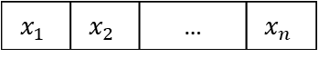
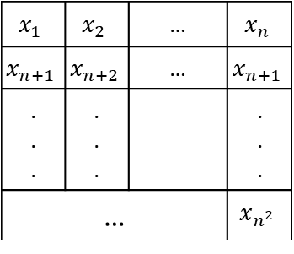
Factorizing the joint distribution
Model explicitly the joint probability distribution of data stream x as a product of element-wise conditional distribution for each element xi in the stream.
Example: An image x of size (n,n) is decomposed scanning pixels in raster mode (Row by row and pixel by pixel within every row)
Apply probability chain rule: xi is the i-th pixel in the image.
Then maximize the likelihood of training data
$$p\left(x\right)= \prod_{i=1}^{n^{2}}{p(x_{i}|x_{1},…,x_{i−1})}$$
Likelihood of image x
Probability of i’th pixel value given all previous pixel values
$$x_{1}$$ | $$x_{2}$$ | … |  | $$x_{n}$$
$$x_{n+1}$$ | $$x_{n+2}$$ | … |  | $$x_{n+1}$$
. . . | . . . |  |  | . . .
… |  |  |  | $$x_{n^{2}}$$
$$x_{1}$$ | $$x_{2}$$ | … | $$x_{n}$$
$$x_{n+1}$$ | $$x_{n+2}$$ | … | $$x_{i−1}$$
$$x_{i}$$ | $$x_{i+1}$$ | … | $$x_{n^{2}}$$
Notes:
1. We want to model the probability or likelihood of this image P of x
2. For these kinds of models we use the chain rule to decompose this likelihood into a product of one dimensional distribution
3. maximize the likelihood of training data

Slide 14
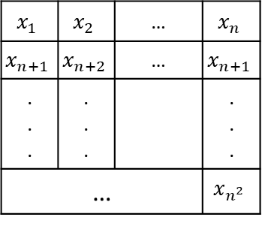
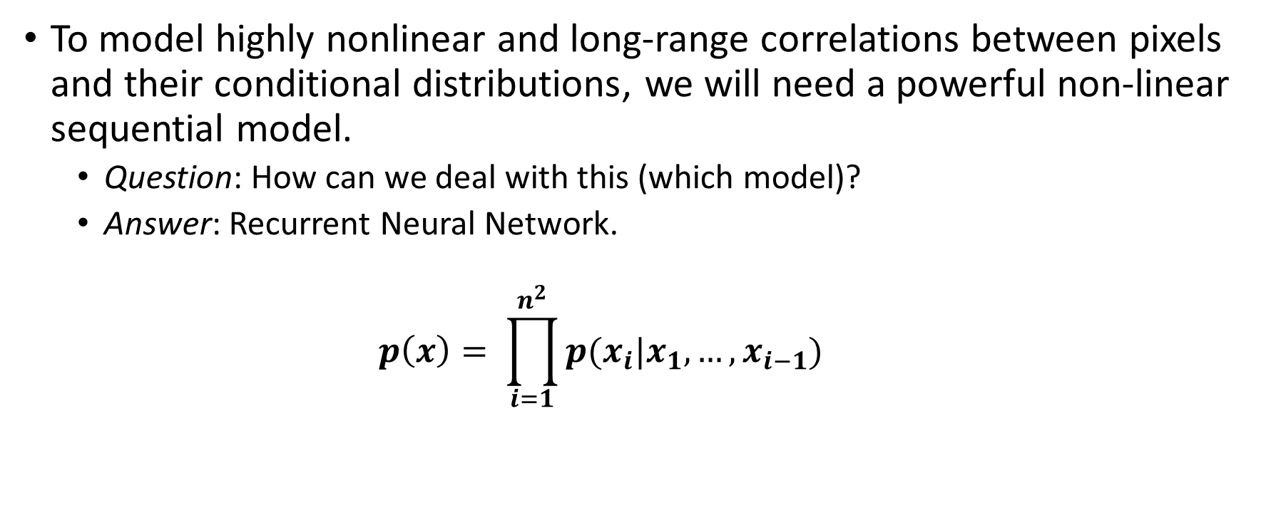
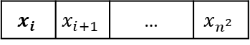
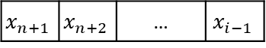
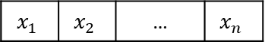
Factorizing the joint distribution
To model highly nonlinear and long-range correlations between pixels and their conditional distributions, we will need a powerful non-linear sequential model.
Question: How can we deal with this (which model)?
Answer: Recurrent Neural Network.
$$p\left(x\right)= \prod_{i=1}^{n^{2}}{p(x_{i}|x_{1},…,x_{i−1})}$$
$$x_{1}$$ | $$x_{2}$$ | … |  | $$x_{n}$$
$$x_{n+1}$$ | $$x_{n+2}$$ | … |  | $$x_{n+1}$$
. . . | . . . |  |  | . . .
… |  |  |  | $$x_{n^{2}}$$
$$x_{1}$$ | $$x_{2}$$ | … | $$x_{n}$$
$$x_{n+1}$$ | $$x_{n+2}$$ | … | $$x_{i−1}$$
$$x_{i}$$ | $$x_{i+1}$$ | … | $$x_{n^{2}}$$

Slide 15
PixelRNN

Slide 16
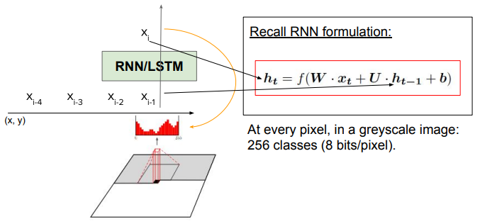
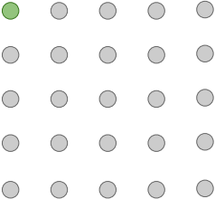
PixelRNN
Generate image pixels starting from corner
Dependency on previous pixels modeled using an RNN (LSTM)
If the image is grayscale then, softmax classifier is applied to every pixel by considering that pixel is belongs to one class from 256 classes
If the image is grayscale then, softmax classifier is applied to every pixel by considering that pixel is belongs to one class from 256 classes

Slide 17
PixelRNN
Drawback: sequential generation is slow
Difficult to train using a GPU
Vanishing gradient problem
Proposed PixelRNN implementation mehods
RowLSTM
DiagonalLSTM
Diagonal BiLSTM

Slide 18
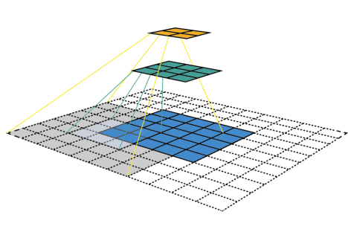
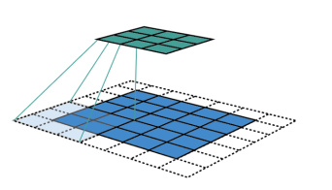
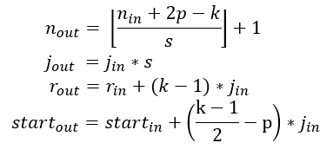
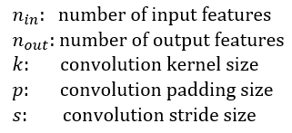
PixelRNN: Receptive field
The receptive field is defined as the region in the input space that a particular feature is looking at (i.e. be affected by).
Feature layer - 2
Feature layer - 1
Feature layer - 1
Input layer
Input layer

Slide 19
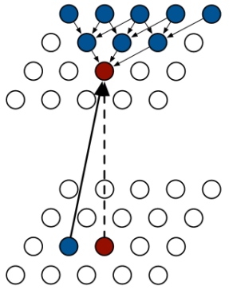
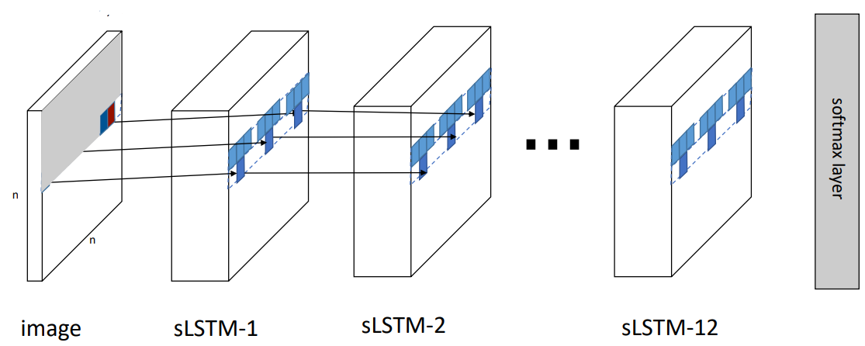
PixelRNN: RowLSTM
First LSTM layer
Image layer
256 classes

Slide 20
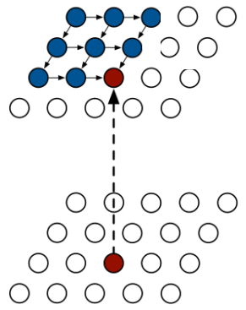
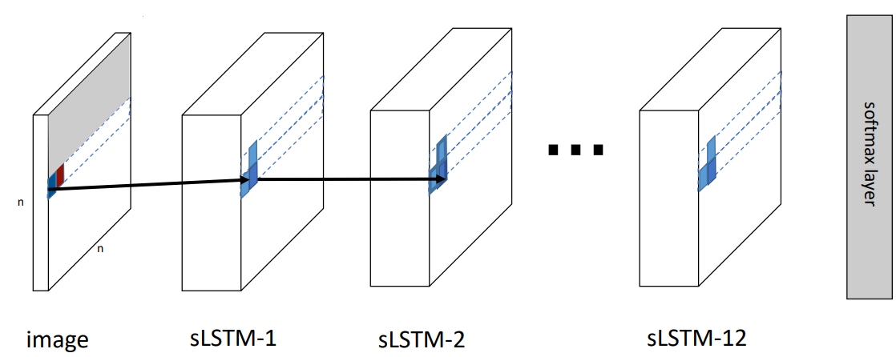
PixelRNN: DiagonalLSTM
256 classes

Slide 21
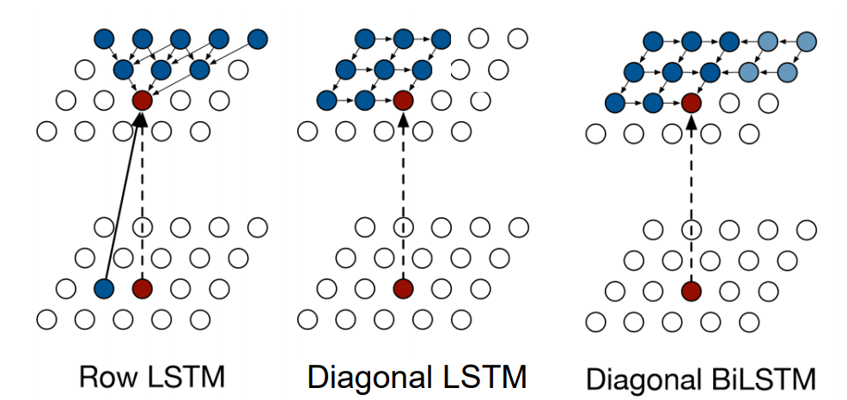
PixelRNN: Receptive Field
Triangular receptive field
Bounded receptive field
Full dependency receptive field

Slide 22
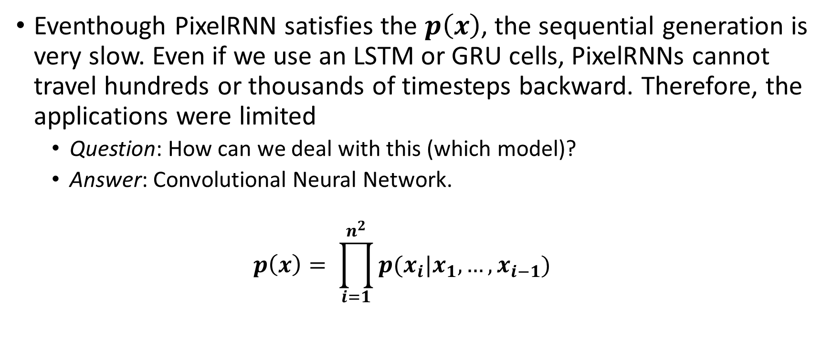
PixelRNN: A Problem
Eventhough PixelRNN satisfies the $p\left(x\right)$, the sequential generation is very slow. Even if we use an LSTM or GRU cells, PixelRNNs cannot travel hundreds or thousands of timesteps backward. Therefore, the applications were limited
Question: How can we deal with this (which model)?
Answer: Convolutional Neural Network.
$$p\left(x\right)= \prod_{i=1}^{n^{2}}{p(x_{i}|x_{1},…,x_{i−1})}$$

Slide 23
PixelCNN

Slide 24
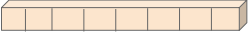
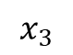
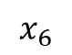
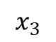
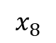
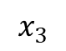
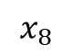
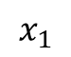
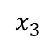
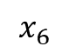
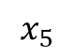
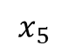
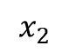
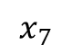
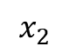


























PixelCNN: When CNN becoming causal…
Let’s say we have a sequence of 100 dimensional vectors describing words
.
.
.
.
.
.
.
.
.
.
.
.
.
.
.
.
.
.
.
.
.
.
.
.
.
.
N dim
.
N dim
$$x_{1}$$
$$x_{5}$$
$$x_{7}$$
$$x_{8}$$
$$x_{2}$$
$$x_{3}$$
$$x_{4}$$
$$x_{6}$$
$$x_{1}$$
$$x_{2}$$
$$x_{3}$$
$$x_{4}$$
$$x_{5}$$
$$x_{6}$$
$$x_{7}$$
$$x_{8}$$
Sequence length = 8
Example 1 : Gray scale image
Example 2 : RGB image
Example 3 : Time series data
.
.
.
N dim
(sensor values or
categorical values)
$$x_{1}$$
$$x_{5}$$
$$x_{8}$$
$$x_{1}$$
$$x_{5}$$
3 dim (R, G, B)
$$x_{2}$$
$$x_{3}$$
$$x_{4}$$
$$x_{6}$$
$$x_{7}$$
$$x_{2}$$
$$x_{3}$$
$$x_{4}$$
$$x_{6}$$
$$x_{7}$$
$$x_{8}$$
$$x_{1}$$
$$x_{5}$$
$$x_{7}$$
$$x_{8}$$
$$x_{2}$$
$$x_{3}$$
$$x_{4}$$
$$x_{6}$$
Sequence length = 8
(8 pixels)
Sequence length = 8
(8 pixels)
Sequence length = 8
8 timestamped samples

Slide 25

PixelCNN: When CNN becoming causal…
Let’s say we have a sequence of 100 dimensional vectors describing a each sample ($x_{i}$) and a convolutional kernel as K1

Slide 26

PixelCNN: When CNN becoming causal…
Keep in mind we are working with 100 dimensions although here we depict just one for simplicity

Slide 27

PixelCNN: When CNN becoming causal…
When we add zero padding, we normally do so on both sides of the sequence (as in image padding)

Slide 28


PixelCNN: CNN becomes causal
Add the zero padding just on the left side of the sequence, not symmetrically
In control theory, a causal system is a system where the output depends on past and current inputs but not the future inputs

Slide 29





PixelCNN: Mask Convolution
Apply masks so a pixel does not see future pixels (in sequential order)
2-D
1-D

Slide 30



PixelCNN: Mask Convolution
Still generate image pixels starting from corner
Dependency on previous pixels now modeled using a CNN over context region
Training: maximize likelihood of training images $p\left(x\right)= \prod_{i=1}^{n^{2}}{p(x_{i}|x_{1},…,x_{i−1})}$
Training is faster than PixelRNN (can parallelize convolutions since context region values known from training images)

Slide 31

PixelCNN: Architecture
256 classes

Slide 32

PixelCNN: Comparison
PixelCNN | PixelRNN-Row LSTM | PixelRNN – Diagonal BiLSTM
Fastest | Slow | Slowest
Bounded receptive field (Blind spot problem) | Triangular receptive field | Full dependency receptive field
Good performances | Worst performances | Best performances

Slide 33


PixelCNN: Receptive Field and Blind Spot
Mask convolutional kernel
Blind Spot
Image
Conv_Layer 1
Conv_Layer 2
Conv_Layer 3

Slide 34

PixelCNN: Masked Convolution summery

Slide 35
PixelCNN: Two improvements
Removal of blind spots in the receptive field by combining the horizontal stack and the vertical stack
Replacement of the ReLu activations between the masked convolutions in the original PixelCNN with the gated activation unit.

Slide 36



PixelCNN: Convolution stacking
Vertical stacking convolution
kernel size to be n//2 + 1 x n instead of n x n, padded input at top, perform convolution operation, then cropped output to preserve spatial dimensions.
So for 3x3 masked kernel, the vertical stacking kernel is 3//2+1 x 3 = 2 x 3
Horizontal stacking convolution
kernel size to be 1 x n//2 + 1 instead of 1 x n with padding and cropping output so the shape stays the same.
So for 3x3 masked kernel, the horizontal stacking kernel is 1 x 3//2 +1= 1 x 2

Slide 37

PixelCNN: Gated Activation
vertical
horizontal

Slide 38

PixelCNN: Whole architecture (Gated PixelCNN)
Masked convolution (Causal Convolution)

Slide 39
An Application Wavenet : Google assistant audio synthesizer

Slide 40








Wavenet
If we consider about the timeseries data, we can change the convolutional kernel size and the hidden layers to control the receptive field
$$p\left(x\right)= \prod_{t=1}^{T}{p(x_{t}|x_{1},…,x_{t−1})}$$
$$x_{t}$$
When,
Masked convolution kernel size is 3
and with 3 hidden layers
receptive field size becomes 5
$$x_{t−5}$$
$$x_{t−4}$$
$$x_{t−3}$$
$$x_{t−2}$$
$$x_{t−1}$$
Receptive field = T

Slide 41
Wavenet
But some time series analysis need to accommodate thousands of time steps backward in the timeseries.
For an example, If we were to predict 1 second of a audio, which is 16kHz sampling = 16000 samples. Model at least need to look back ½ second, which is 8000 samples (timesteps) to predict the next samples.
So might need to add many hidden layers or need to increase convolution kernel size dramatically, which are not stable solutions
RNN only or LSTMs only capable of looking back for five 100 samples maximum
Question: How can we deal with this ?
Answer: Dilated convolutions.

Slide 42

Wavenet: Dilated convolutions
Here we perform convolution with kernel size of 3 (3x3). First image show that all neighbor pixel participate in calculating output. Second image takes every 2nd input and we speak about dilation factor of 2. Third image takes every 4th, dilation factor of 4. Regular convolutions take every 1st (all) inputs so dilation is 1.
Dilated with
factor of 2
Dilated with
factor of 4
Kernel size= 3
Notes:
Here we perform convolution with kernel size of 3 (3x3). First image show that all neighbor pixel participate in calculating output. Second image takes every 2nd input (that is, dilate input) and we speak about dilation rate (or factor) of 2. Third image takes every 4th, dilation rate is 4. Regular convolutions take every 1st (all) inputs so dilation rate is 1.

Slide 43


Wavenet: Dilated convolutions
One can think about dilated convolution as expanding filter weight matrix with zeros interspersing actual weights like mask convolution
Dilation = 2, 1-D kernel
Dilation = 2, 2-D kernel

Slide 44








Wavenet
$$x_{t}$$
$$p(x_{t}|x_{1},…,x_{t−5})$$
Now with dilated convolutions, every layer is exponentially increasing the spacing such that the receptive field in the last unit is seeing more and more span with the same amount of layers
Dilated convolutions help us reach a receptive field sufficiently large to emulate an RNN!
$$x_{t−5}$$
$$x_{t−4}$$
$$x_{t−3}$$
$$x_{t−2}$$
$$x_{t−1}$$
With dilation
$$x_{t}$$
$$p(x_{t}|x_{1},…,x_{t−16})$$
Masked
convolution
$$x_{t−16}$$
$$x_{t−1}$$

Slide 45

Wavenet
$$x_{t}$$
$$p(x_{t}|x_{1},…,x_{t−5})$$
Now with dilated convolutions, every layer is exponentially increasing the spacing such that the receptive field in the last unit is seeing more and more span with the same amount of layers
Dilated convolutions help us reach a receptive field sufficiently large to emulate an RNN!
$$x_{t−5}$$
$$x_{t−4}$$
$$x_{t−3}$$
$$x_{t−2}$$
$$x_{t−1}$$
With dilation

Slide 46







Wavenet: Architecture
Masked Convolution
Input
Used μ-low companding transformation to the data,
and then quantize it to 256 possible values
Output
Masked Convolution = Causal Convolution
Notes:
Causal Convolution

Slide 47


Results
PixelCNN/PixelRNN.
Wavenet

Slide 48
Pros and Con
Pros:
Can explicitly compute likelihood p(x)
Explicit likelihood of training data gives good evaluation metric
Good samples
Con:
Sequential generation is still slow,
Ex: wavenet forward 16000 times in autoregressive way to predict 1 second of audio at standard 16kHz sampling.
Improving PixelCNN performance
Gated PixelCNN
Short-cut connections
Training tricks

Slide 49
References
Papers
PixelRNN/PixelCNN - Pixel Recurrent Neural Networks https://arxiv.org/pdf/1601.06759.pdf
Spatial LSTMs - Generative Image Modeling Using Spatial LSTMs https://arxiv.org/pdf/1506.03478.pdf
Masked convolution - MADE: Masked Autoencoder for Distribution Estimation http://proceedings.mlr.press/v37/germain15.pdf
Dilated Convolution - MULTI-SCALE CONTEXT AGGREGATION BY DILATED CONVOLUTIONS https://arxiv.org/pdf/1511.07122.pdf
Gated PixelCNN - Conditional Image Generation with PixelCNN Decoders https://arxiv.org/pdf/1606.05328.pdf
Wavenet - WAVENET: A GENERATIVE MODEL FOR RAW AUDIO https://arxiv.org/pdf/1609.03499.pdf
Other
https://deepmind.com/blog/wavenet-generative-model-raw-audio/
https://ctmakro.github.io/site/on_learning/audio/wavenet_arch.html
http://sergeiturukin.com/2017/02/22/pixelcnn.html
https://wiki.math.uwaterloo.ca/statwiki/index.php?title=STAT946F17/Conditional_Image_Generation_with_PixelCNN_Decoders#Reference
https://www.youtube.com/watch?v=5WoItGTWV54&t=711s
https://www.youtube.com/watch?v=FeJT8ejgsL0&t=873s
https://www.youtube.com/watch?v=BLuiOQ7cBcI

Slide 50
Thank You

